Slide 1
UML Study Buddy App
Hussain Dar and Sridhar Rangan

Slide 2
Goal
UML Study Buddy App is designed to help students get to know other students in specific classes
This is so that these students can meet up to work together on homework, study for quizzes and exams, and do group projects together.
The app will be available for all students and will help introverted students and those who need help in their classes find additional help with peers.

Slide 3
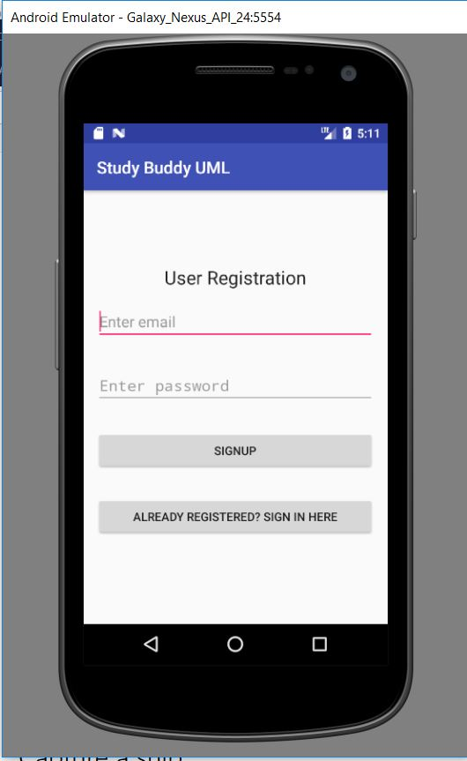
Here is a basic UI for the Database.
This prompts the user to register an email for the Study Buddy Application.
If the User already has an account, they can click the button at the bottom which will bring them to a user sign on page.
Should the account exist the database, it will welcome the user

Slide 4
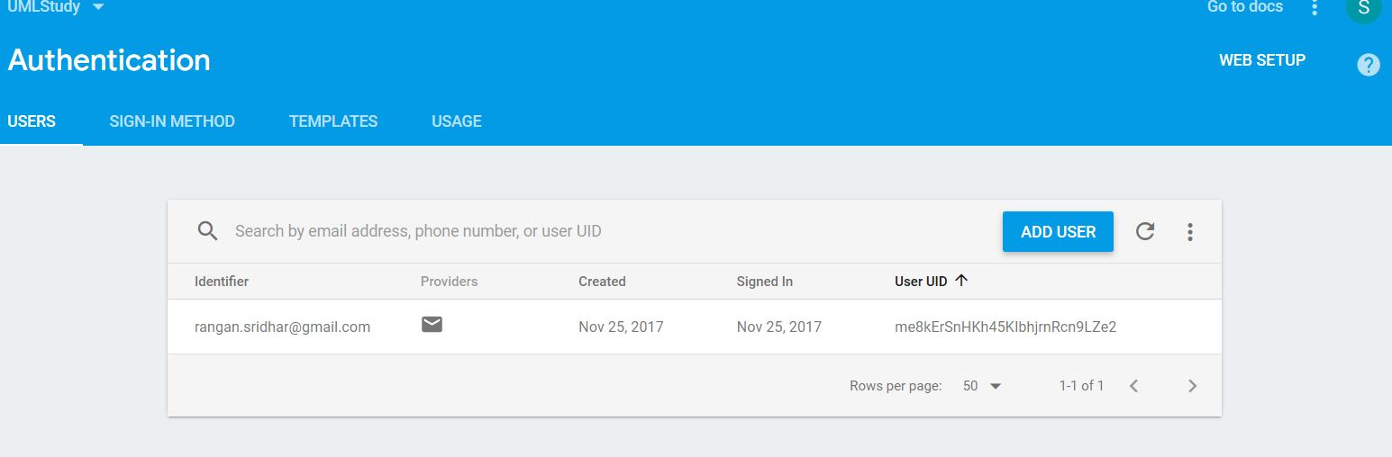
Added User into Database

Slide 5
What has each person done
Sridhar Rangan – Worked on Firebase and the implementation of accounts. Now have a working database with the ability to add accounts through emails as well as log in if an email has been registered.
Hussain Dar – Working on creating an list of classes for students to choose from and customizing the UI.
Both – Will need to work on merging the database/accounts to the be able to view the list of classes.

Slide 6
Challenges
Ran into some difficulty implementing the firebase database and having users be able to login but problems were resolved over break.
Hopefully we will be able to now merge both components and have a complete app by next week’s checkpoint.

